Slide 1
A THEORITICAL FRAMEWWORK FOR A WEARABLE IONTOPHORESIS BASED DRUG DELIVERY SYSTEM FOR STRESS DETECTION AND REGULATION WITH WEBSITE DEPLOYEMENT
SUPERVISOR: Dr. A.Sirajudeen
TEAM MEMBERS: Mohanish Pattanaik-(23BHI10049)
Arpit Pattanaik-(23BHI10081)
Ayushi Taralkar-(23BHI10057)
Akshaya Murugan-(23BHI10047)
Anamika-(23BHI10161)

Slide 2
INTRODUCTION
Wearable iontophoresis-based drug delivery System is an innovative technology that integrates machine learning (ML)-based stress detection with a web application to provide real-time, controlled medication administration. This approach leverages iontophoresis, a technique that uses low electrical currents to drive drug molecules through the skin, ensuring precise and non-invasive drug delivery.
Stress detection is a critical component of this system. Medical conditions like hypertension, anxiety, and cardiovascular disorders are often influenced by stress levels. By continuously monitoring physiological stress markers such as heart rate variability and skin conductance, the system can dynamically adjust medication release to optimize therapeutic outcomes.
This closed-loop system ensures real-time response and personalized treatment, improving patient compliance and health outcomes.

Slide 3
What is Iontophoresis?
Iontophoresis is a non-invasive technique that uses a low electric current to drive charged drug molecules across the skin and into the bloodstream. This method enhances drug penetration by utilizing an electric field to overcome the skin's natural barrier, ensuring targeted and controlled medication delivery.
How Does Iontophoresis Work?
Iontophoresis operates by applying a small, controlled direct current (DC) through an electrode placed on the skin. The charged drug molecules are repelled from a similarly charged electrode, driving them through the skin and into the bloodstream. This process ensures a precise and controlled drug release, minimizing unwanted side effects.

Slide 4
Why Wearable Drug Delivery?
Traditional drug administration methods have several limitations.
Oral Medications
Oral drugs often face slow absorption through the digestive system. They also undergo metabolism in the liver, reducing their bioavailability. Additionally, systemic distribution may cause potential side effects.
Injections
Injections are invasive and often painful, requiring professional administration. They also pose risks such as infections and needle-related anxiety.
Wearable Iontophoresis
Wearable iontophoresis offers a pain-free alternative with no needles, reducing patient discomfort. It ensures steady and precise medication dosing while enabling real-time response adjustments based on physiological needs.

Slide 5
How AI & Machine Learning Improve Iontophoretic Drug Delivery ?
Machine learning (ML) plays a crucial role in optimizing wearable iontophoresis. AI algorithms analyze biometric data, such as heart rate and skin conductance, to detect real-time stress levels. ML models predict the optimal medication dosage based on individual physiological responses. The system dynamically adjusts drug release to maintain therapeutic effectiveness while minimizing side effects.

Slide 6
PROBLEM STATEMENT
Traditional drug delivery methods, like oral medications and injections, lack precision and adaptability. Oral drugs face delays due to metabolism, while injections are invasive and reduce patient adherence. For conditions like anxiety, hypertension, and chronic pain, timely drug administration is critical. Wearable iontophoresis, combined with AI-driven stress detection, enables real-time, non-invasive, and automated drug delivery, ensuring personalized and immediate treatment for better patient outcomes.

Slide 7
LITERATURE REVIEW
Title: An integrated Mg battery-powered iontophoresis patch for efficient and controllable transdermal drug delivery [1]
Authors: (Yan Zhou et al.[2023])
Findings And Conclusions:
This study introduces a magnesium (Mg) battery-powered iontophoresis patch for efficient, controlled transdermal drug delivery. By integrating iontophoresis with an innovative Mg-based battery, the system enables precise drug release, offering improved performance over traditional methods. The patch applies a consistent, low-voltage current to regulate drug flow through the skin, providing advantages like localized delivery with fewer side effects. The research highlights its potential for broader therapeutic applications, representing a breakthrough in non-invasive, wearable medical technology.

Slide 8
LITERATURE REVIEW
Title: A Review on Mental Stress Detection Using Wearable Sensors and Machine Learning Techniques [2] [7]
Authors: (S. Gedam and S. Paul [2021])
Findings And Conclusions:
The authors examine the use of wearable sensors, such as electrodermal activity (EDA) and heart rate variability (HRV), for detecting mental stress. They highlight how machine learning algorithms can analyze sensor data to accurately classify stress levels, offering a non-invasive and efficient approach to monitoring stress in real-time.
The review emphasizes the potential of combining wearable technology with machine learning for personalized stress detection, while also addressing challenges like sensor accuracy and the need for large datasets. This approach shows promise for applications in mental health care, workplace stress management, and everyday monitoring.

Slide 9
LITERATURE REVIEW
Title: A Two-Stage Biomedical Event Trigger Detection Method Based on Hybrid Neural Network and Sentence Embeddings [3] [5]
Authors: ( X. He et al. [2021])
Findings And Conclusions:
The authors propose a two-stage method combining a hybrid neural network and sentence embeddings to detect biomedical event triggers in text. The first stage identifies potential triggers, while the second refines predictions using semantic information from sentence embeddings.
This approach improves event detection accuracy compared to traditional methods, enhancing automated biomedical text mining. It offers promising applications in bioinformatics, such as knowledge discovery, drug development, and clinical decision-making.

Slide 10
The Traditional drug administration methods used currently are either through oral medication or drug delivery through injections. These methods have several limitations.
Oral Medications
Oral drugs often face slow absorption through the digestive system. They also undergo metabolism in the liver, reducing their bioavailability. Additionally, systemic distribution may cause potential side effects.
Injections
Injections are invasive and often painful, requiring professional administration. They also pose risks such as infections and needle-related anxiety.
EXISTING MODEL

Slide 11
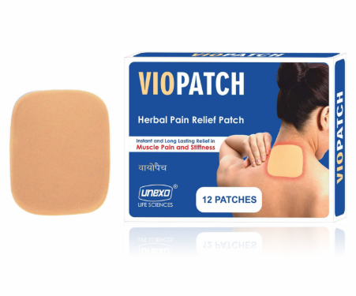
EXISTING MODEL
A pain relief patch is a medicated adhesive patch applied to the skin to deliver pain-relieving drugs directly to the affected area. It provides localized relief from muscle or joint pain, commonly using ingredients like menthol, lidocaine, or diclofenac. These patches are easy to use, non-invasive, and offer sustained drug release over several hours.
A pain relief patch is a medicated adhesive patch applied to the skin to deliver pain-relieving drugs directly to the affected area. It provides localized relief from muscle or joint pain, commonly using ingredients like menthol, lidocaine, or diclofenac. These patches are easy to use, non-invasive, and offer sustained drug release over several hours.

Slide 12
PROPOSED WORK
The wearable iontophoresis drug delivery system operates through four key
steps:
Simulated Data Collection – Instead of relying on Real-time biosensor’s data, we will be using physiological data such as heart rate variability and skin conductance that will be generated using statistical models and synthetic datasets. This ensures realistic stress-level fluctuations, allowing accurate testing of the system.
Machine Learning Analysis – The ML model processes the generated data using feature extraction techniques to identify stress-related patterns. The system classifies stress levels by analyzing variations in the simulated signals.
Web Application Visualization – A user-friendly web interface displays real-time stress simulations, allowing users to monitor stress patterns and drug administration decisions. The dashboard provides graphical insights, alerts, and historical trend analysis for research and evaluation.
Automated Drug Release Simulation – Upon detecting elevated stress levels, the system simulates the activation of the iontophoresis mechanism. Instead of physical drug delivery, the system will output a log of simulated drug release events, dosage adjustments, and timestamps for evaluation.

Slide 13
HARDWARE & SOFTWARE REQUIREMENTS
Hardware:
Wearable iontophoresis patch
Microcontroller (Arduino/Raspberry Pi)
Sensors for stress detection (e.g., ECG, GSR sensors)
Battery-powered drug reservoir
Software:
Frontend: HTML, CSS, JavaScript (React.js)
Backend: Node.js
Database: MongoDB
Machine Learning: Python, TensorFlow, Scikit-learn.

Slide 14
ARCHITECTURE DIAGRAM

Slide 15
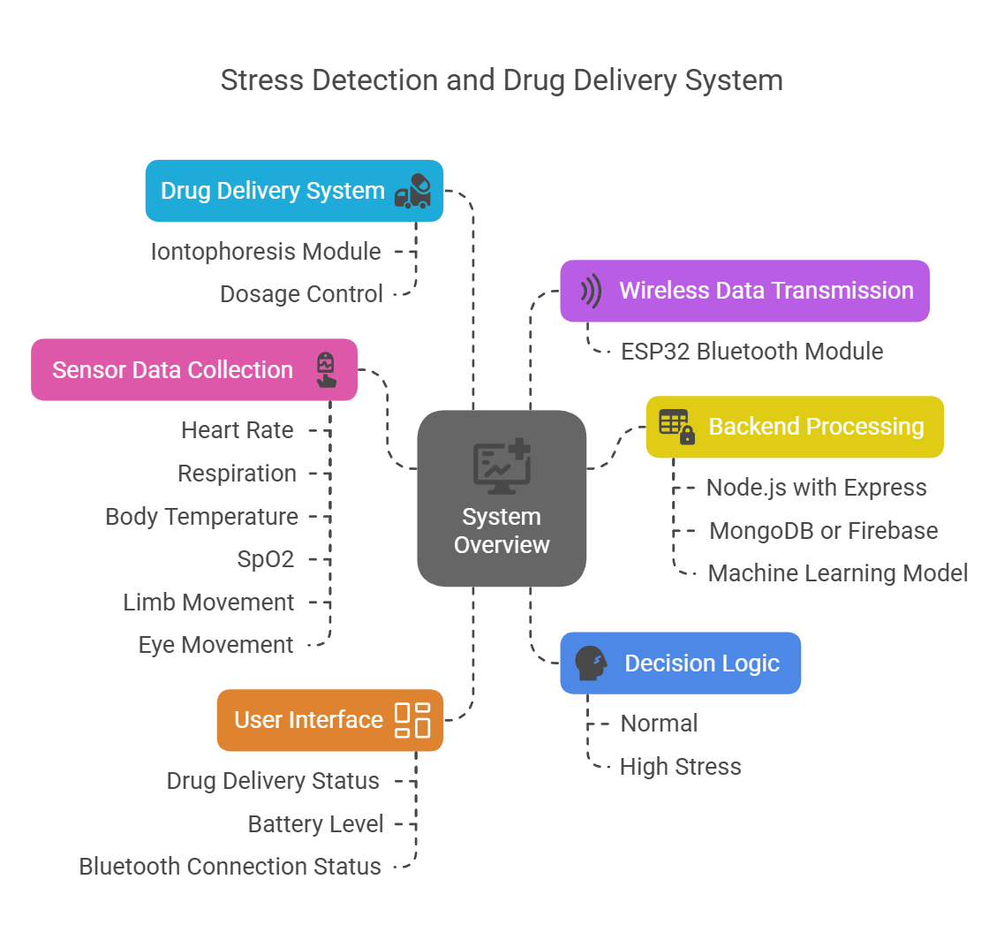

Slide 16
FLOW DIAGRAM

Slide 17
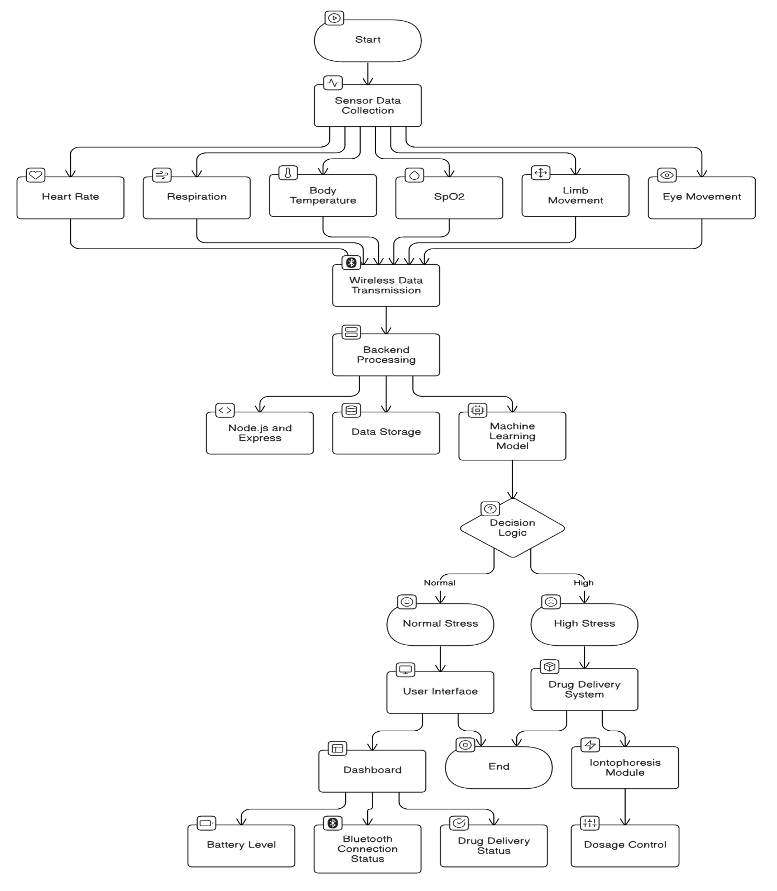

Slide 18
PERFORMANCE ANALYSIS OF FINALIZED MACHINE LEARNING MODEL IN PATCHEZ

Slide 19
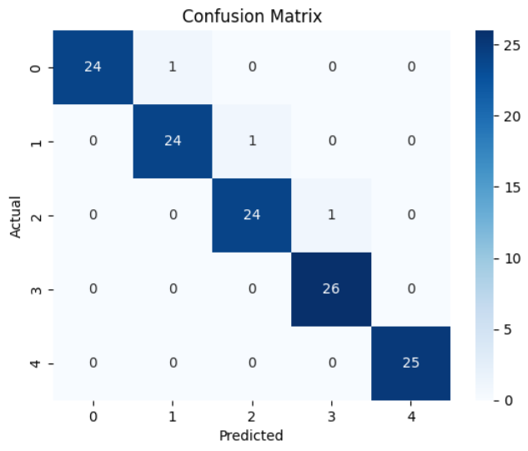
1. Confusion Matrix – Model Performance Overview. This confusion matrix visualizes the classification performance of the stress level prediction model across five categories (0 to 4).

Slide 20
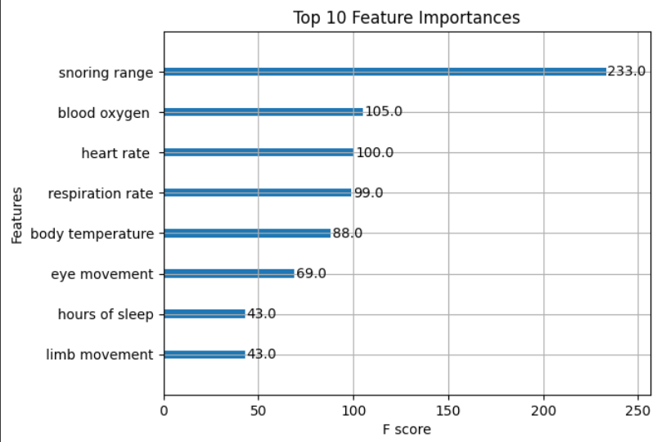
2. Feature Importance – Key Physiological Indicators. This bar chart highlights the top 8 physiological features ranked by their contribution to the model’s predictions (based on F-score).

Slide 21
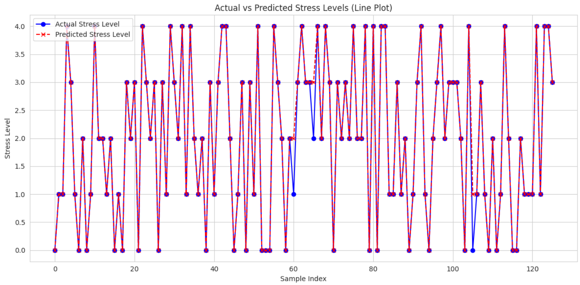
3. Actual vs Predicted Stress Levels – Model Accuracy Visualization. This line plot compares actual and predicted stress levels across 125+ samples. The close alignment between the blue (actual) and red (predicted) lines signifies excellent prediction accuracy.

Slide 22
WEBSITE OVERVIEW
PatchEZ is a web application designed to support a wearable iontophoresis-based drug delivery system. It provides users with real-time tracking, stress level monitoring, and device status updates. The platform ensures an efficient and controlled drug delivery process while integrating machine learning for stress detection.

Slide 23
WEBSITE OVERVIEW
PatchEZ is a web application designed to support a wearable iontophoresis-based drug delivery system. It provides users with real-time tracking, stress level monitoring, and device status updates. The platform ensures an efficient and controlled drug delivery process while integrating machine learning for stress detection.

Slide 24
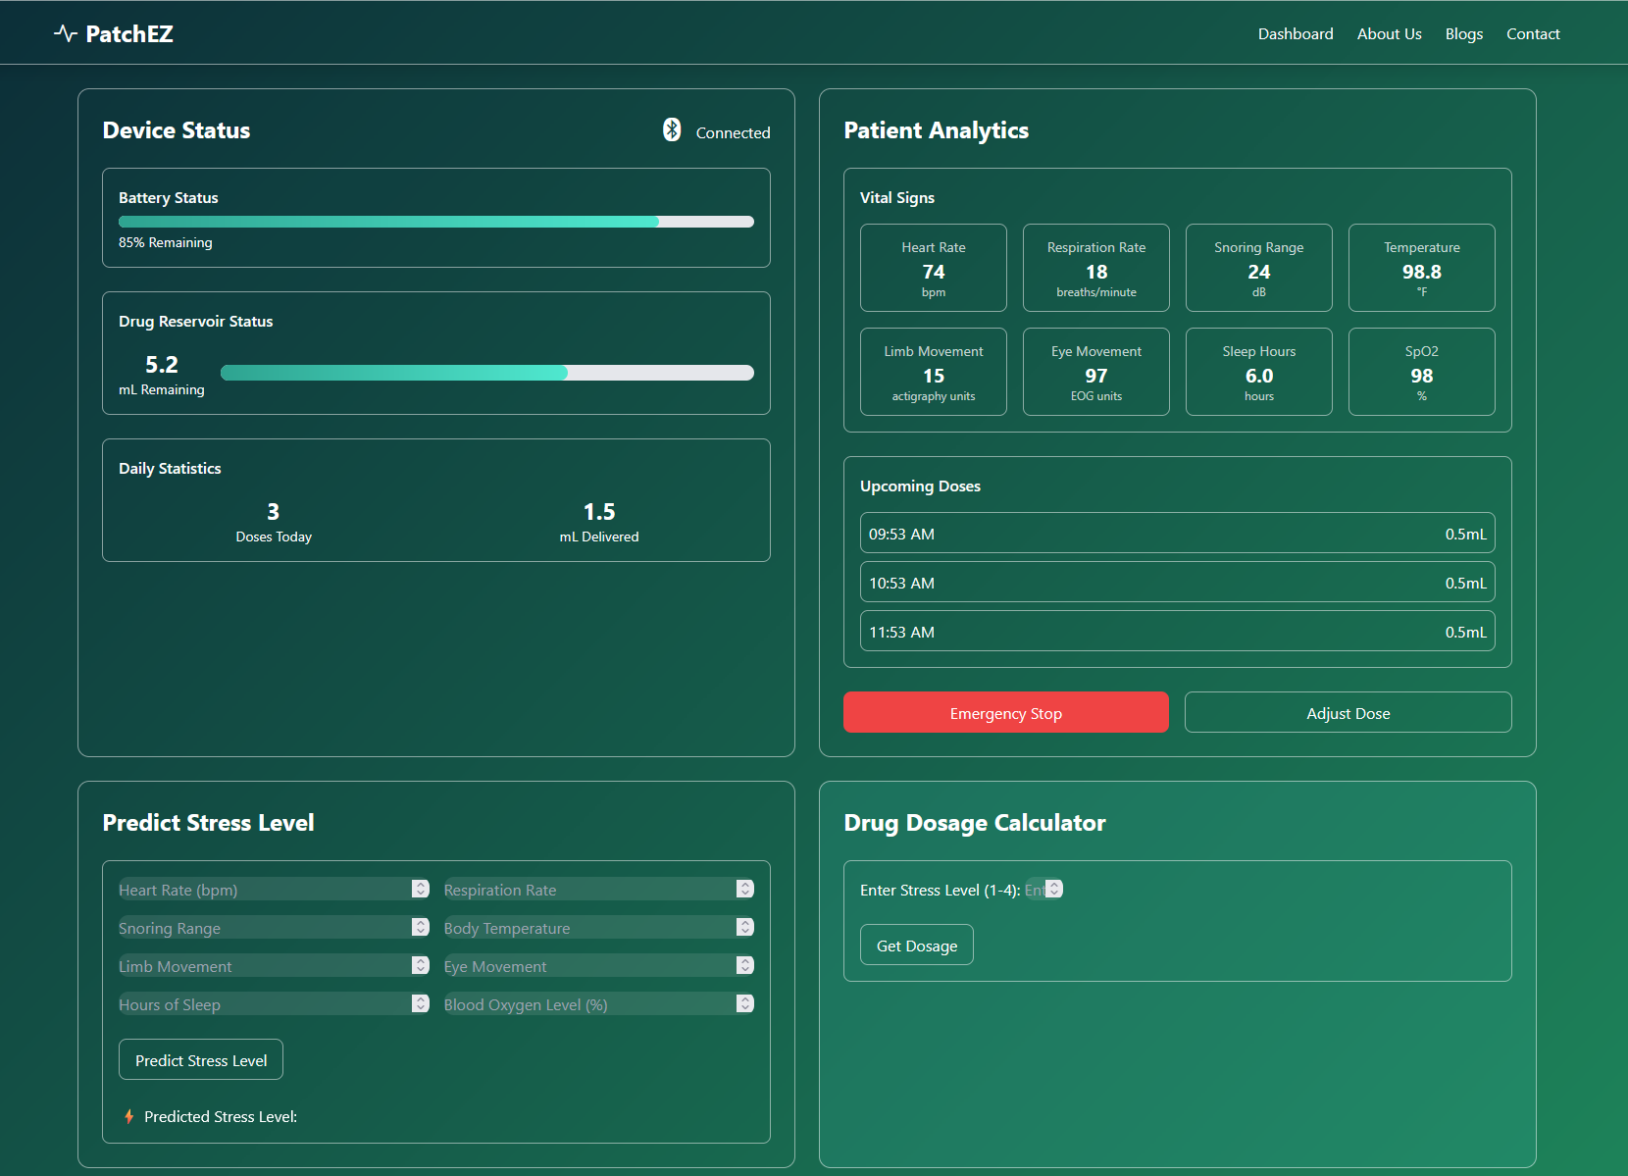

Slide 25


Slide 26
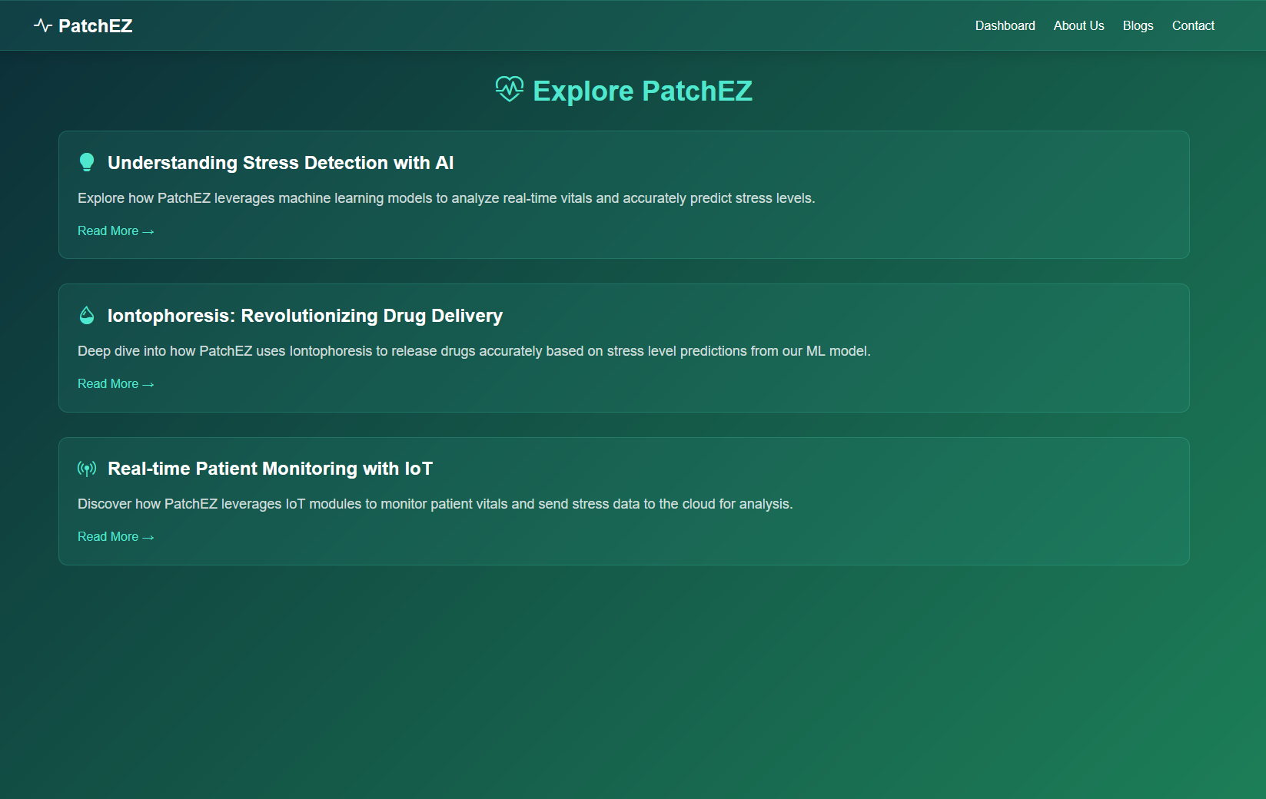

Slide 27
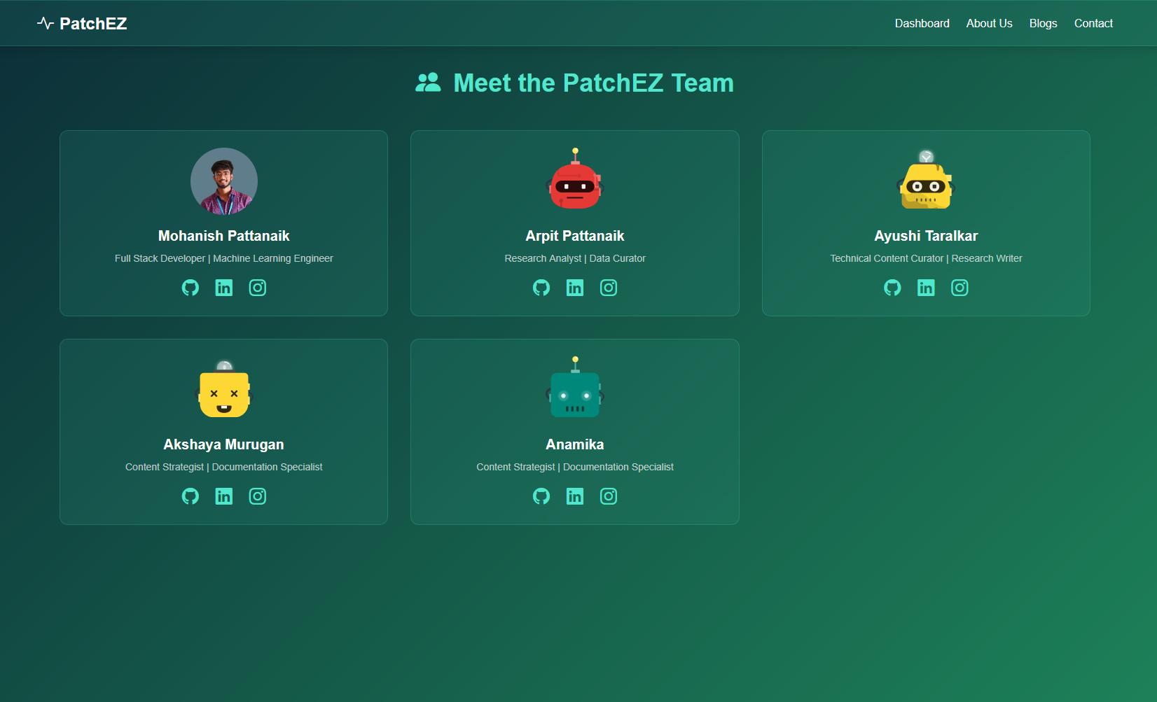

Slide 28
REAL-TIME USAGE
1. ANXIETY & STRESS MANAGEMENT
Individuals with generalized anxiety disorder (GAD), panic disorder, or PTSD often experience sudden anxiety episodes that require immediate intervention. Traditional medications like benzodiazepines take time to act and require oral intake, which may not be practical during a panic attack.
2. CHRONIC PAIN RELIEF
CHRONIC PAIN CONDITIONS SUCH AS FIBROMYALGIA, ARTHRITIS, AND LOWER BACK PAIN REQUIRE CONSISTENT MEDICATION, BUT TRADITIONAL METHODS LIKE PAINKILLERS HAVE SYSTEMIC SIDE EFFECTS AND RISK OF DEPENDENCY.
3. CARDIOVASCULAR HEALTH MONITORING & BLOOD PRESSURE REGULATION
HIGH BLOOD PRESSURE (HYPERTENSION) IS A LEADING CAUSE OF HEART DISEASE, STROKE, AND KIDNEY FAILURE. MANY PATIENTS EXPERIENCE STRESS-INDUCED HYPERTENSION, REQUIRING IMMEDIATE INTERVENTION TO PREVENT COMPLICATIONS.
4. POST-SURGICAL RECOVERY & PAIN MANAGEMENT
AFTER SURGERY, PAIN MANAGEMENT AND CONTROLLED MEDICATION DOSING ARE CRUCIAL TO PREVENT OPIOID OVERUSE AND COMPLICATIONS SUCH AS DEEP VEIN THROMBOSIS (DVT).
5. ATHLETE RECOVERY & PERFORMANCE OPTIMIZATION
PROFESSIONAL ATHLETES FREQUENTLY SUFFER FROM MUSCLE FATIGUE, INFLAMMATION, AND INJURIES THAT REQUIRE IMMEDIATE PAIN RELIEF AND RECOVERY AGENTS. TRADITIONAL ORAL MEDICATIONS ARE SLOW, AND INJECTIONS CAN INTERFERE WITH TRAINING.

Slide 29
Patients with chronic conditions (e.g., hypertension, anxiety disorders) benefit from automated drug administration.
Post-surgical pain management with controlled drug delivery.
Athlete recovery through stress-adaptive pain relief patches.
Neurological disorder treatments (e.g. Epilepsy).
OTHER APPLICATIONS

Slide 30
MODULES
Drug Monitoring System: Tracks dosage, delivery timing, and battery status.
Stress Detection Module: ML model processes physiological signals to detect stress.
Wearable Device Control: Microcontroller regulates iontophoresis drug release.
Web Dashboard: Displays real-time data to users and healthcare providers.

Slide 31
REFERENCES
Zhou, Y., Jia, X., Pang, D. et al. An integrated Mg battery-powered iontophoresis patch for efficient and controllable transdermal drug delivery. Nat Commun 14, 297 (2023). https://doi.org/10.1038/s41467-023-35990-7 [1]
Taskasaplidis, Georgios & Fotiadis, Dimitris & Bamidis, Panagiotis. (2024). Review of Stress Detection Methods Using Wearable Sensors. IEEE Access. PP. 1-1. 10.1109/ACCESS.2024.3373010. https://www.researchgate.net/publication/378725858_Review_of_Stress_Detection_Methods_Using_Wearable_Sensors [2]
Ancillon L, Elgendi M, Menon C. Machine Learning for Anxiety Detection Using Biosignals: A Review. Diagnostics (Basel). 2022 Jul 25;12(8):1794. doi: 10.3390/diagnostics12081794. PMID: 35892505; PMCID: PMC9332282. https://pmc.ncbi.nlm.nih.gov/articles/PMC9332282/ [3]
S. Gedam and S. Paul, "A Review on Mental Stress Detection Using Wearable Sensors and Machine Learning Techniques," in IEEE Access, vol. 9, pp. 84045-84066, 2021, doi: 10.1109/ACCESS.2021.3085502. https://ieeexplore.ieee.org/document/9445082 [4]

Slide 32
REFERENCES
X. He, Y. Ren, P. Tai and H. Shi, "A Two-Stage Biomedical Event Trigger Detection Method Based on Hybrid Neural Network and Sentence Embeddings," in IEEE Access, vol. 9, pp. 81926-81935, 2021, doi: 10.1109/ACCESS.2021.3085992. https://ieeexplore.ieee.org/document/9446136 [5]
Gupta SK, Shah JC, Hwang SS. Pharmacokinetic and pharmacodynamic characterization of OROS and immediate-release amitriptyline. Br J Clin Pharmacol. 1999 Jul;48(1):71-8. doi: 10.1046/j.1365-2125.1999.00973.x. PMID: 10383563; PMCID: PMC2014871. https://pubmed.ncbi.nlm.nih.gov/10383563/ [6]
U. Kamoto, Y. Isoda and H. Ota, "Wearable Iontophoresis Device Using Stretchable Electrodes Towards Transdermal Delivery," 2019 20th International Conference on Solid-State Sensors, Actuators and Microsystems & Eurosensors XXXIII (TRANSDUCERS & EUROSENSORS XXXIII), Berlin, Germany, 2019, pp. 2255-2257, doi: 10.1109/TRANSDUCERS.2019.8808388. https://ieeexplore.ieee.org/document/8808388 [7]

